Slide 1
CSS3 – An Overview
Cascading Style Sheet – The Cloth of the Web

Slide 2

What is CSS?
Definition:
CSS stands for Cascading Style Sheets, used to style HTML elements.
Purpose:
CSS controls the layout and appearance of web pages.

Slide 3
What’s New in CSS3?
Explanation:
CSS3 is the latest version with new features for styling and layout.
Key Features:
New selectors
Media queries
Animations & transitions
Improved color options

Slide 4
CSS v/s CSS3
CSS
CSS3
Single large specification
Basic selectors (element, class, ID)
Limited animations (only with JavaScript)
Basic layout (float-based)
No media queries
No support for border-radius
No shadows support
Basic color formats (Hex, RGB)
No support for rounded corners
Split into smaller modules (e.g., Flexbox, Grid)
Advanced selectors (nth-child, attribute selectors)
Built-in animations and transitions
Advanced layout (Flexbox, Grid layout)
Media queries for responsive design
border-radius property supported
Shadows supported (box-shadow, text-shadow)
Advanced color formats (RGBA, HSL)
Rounded corners supported with border-radius

Slide 5
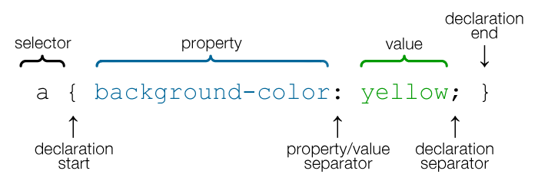
CSS Syntax
Basic Structure:
selector {
property: value;
}
Example:
p {
color: blue;
}

Slide 6
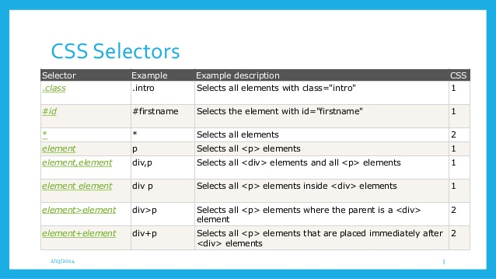
CSS Selectors
Element Selector:
Targets HTML elements (e.g., h1, p)
Class Selector:
Targets elements with a class (e.g., .className)
ID Selector:
Targets an element with a specific ID (e.g., #id)
Universal Selector:
Targets all elements (*)

Slide 7
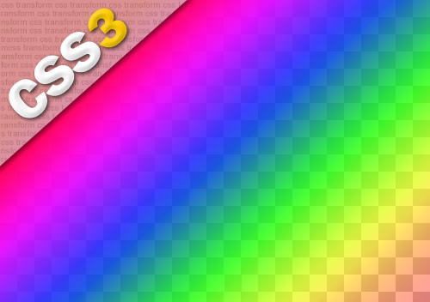
Colors in CSS3
Hexadecimal: #ff5733
RGB: rgb(255, 87, 51)
RGBA: rgba(255, 87, 51, 0.5) (includes transparency)
HSL: hsl(9, 100%, 60%)

Slide 8
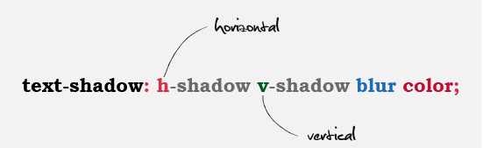
CSS3 Borders and Shadows
Borders:
Add borders to elements (border: 1px solid black)
Border-radius:
Round corners (border-radius: 10px)
Box Shadow:
Add shadows to elements (box-shadow: 2px 2px 5px gray)

Slide 9

CSS3 Fonts and Text Effects
Font Properties:
font-family: Define font styles (e.g., Arial, sans-serif)
font-size: Set text size
font-weight: Control text boldness
Text Effects:
text-shadow: Add shadows to text
text-transform: Change text case (e.g., uppercase)

Slide 10
CSS3 Layout (Flexbox)
Flexbox:
A layout model for aligning elements
Example
.container {
display: flex;
justify-content: center;
align-items: center;
}

Slide 11
CSS3 Transitions
Definition:
Allows smooth changes between styles
Example:
div {
transition: all 0.5s ease;
}

Slide 12
CSS3 Animations
Definition:
Create animations with keyframes
Example:
@keyframes myAnimation {
from {opacity: 0;}
to {opacity: 1;}
}

Slide 13
Media Queries (Responsive Design)
Purpose:
Make websites responsive
Example:
@media (max-width: 600px) {
body {
background-color: lightblue;
}
}

Slide 14

Conclusion
Recap:
CSS3 enhances styling with advanced features.
Key Takeaway:
Use CSS3 to create visually appealing, responsive websites.

Slide 15
Thank You! Under the Guidance of Indrakka Mam Edubridge * Capgemini - Shridhar Pandey

